Slide 1


Optimizing Virtual Memory Performance: A Simulation with Paging and Advanced Page Replacement Algorithms
SAVEETHA INSTITUTE OF MEDICAL AND TECHINCAL SCIENCES
BY
G.SHREENIDHI (192211161)
KAREN INFANTA ROZARIO(192211155)
SUPERVISOR
Dr .A . Terrance Frederick Fernandez

Slide 2

Introduction
In this presentation, we will explore Optimizing Virtual Memory Performance through simulation of paging and advanced page replacement algorithms. We will delve into the impact on system performance and the role of algorithms.

Slide 3

Virtual Memory Basics
Understanding the concept of virtual memory is essential for optimizing system performance. It allows the system to use a combination of RAM and disk storage to effectively manage memory demands. We will explore the beneﬁts and challenges of virtual memory.

Slide 4
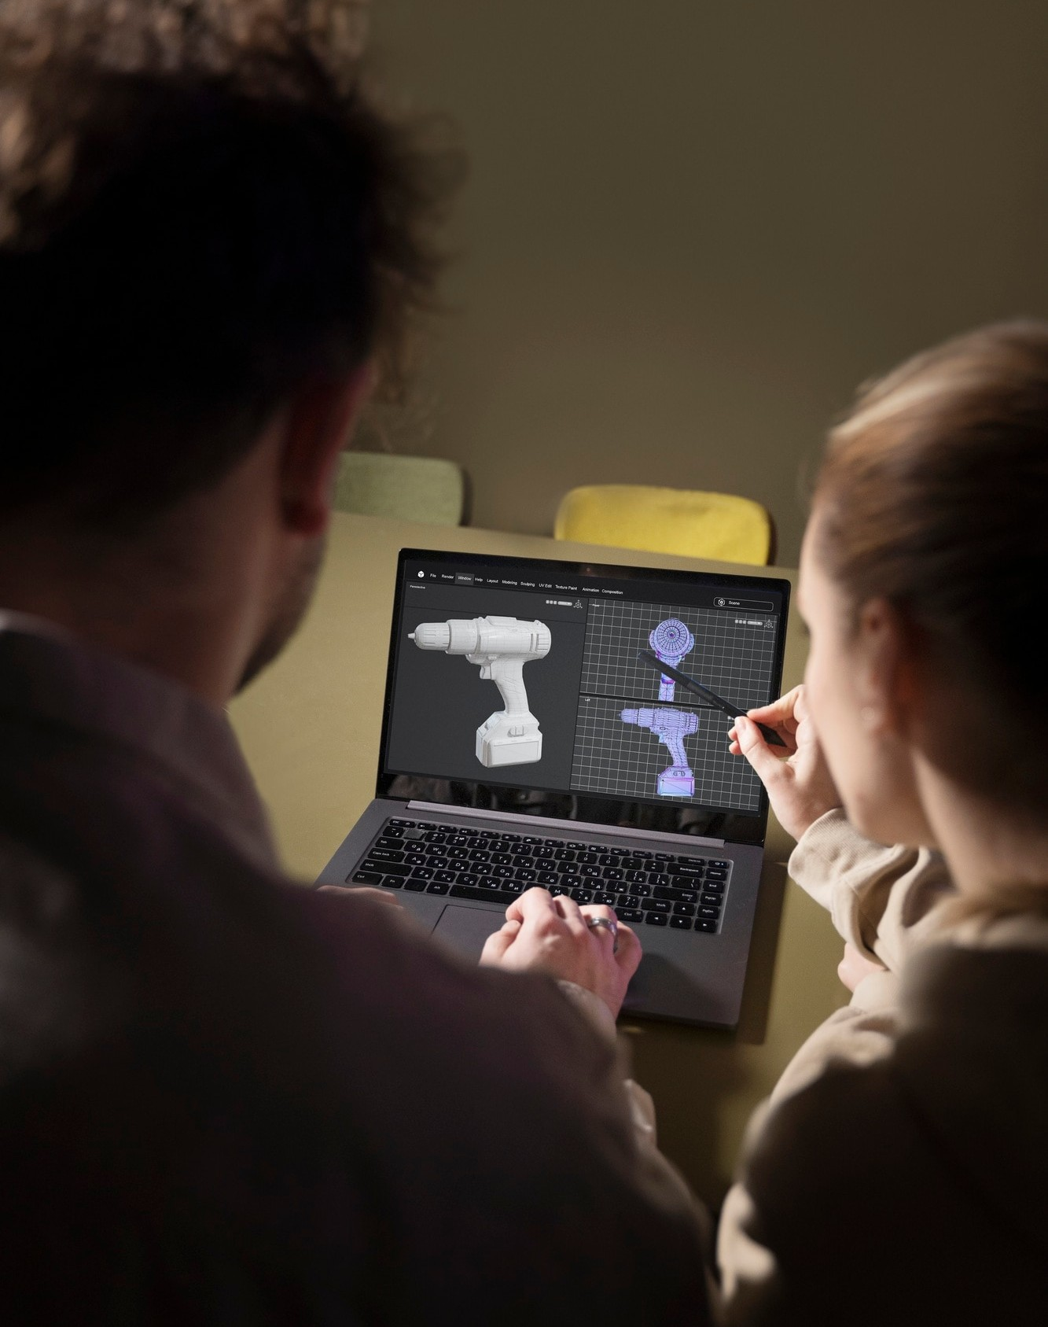
Paging Mechanism
The paging mechanism is a key component of virtual memory management. It involves dividing the physical memory into ﬁxed-size pages to facilitate efﬁcient memory allocation.
We will analyze the impact of paging on system performance.

Slide 5

Page Replacement Algorithms
Various page replacement algorithms play a crucial role in optimizing virtual memory performance. We will explore popular algorithms such as LRU (Least Recently Used) and LFU (Least Frequently Used) to understand their impact on system efﬁciency.

Slide 6

Simulation Setup
To analyze the performance of virtual memory, we will set up a simulation environment to evaluate the effectiveness of different page replacement algorithms. The simulation will provide valuable insights into the behavior of these algorithms under varying workloads.

Slide 7

Results Analysis
The results of the virtual memory simulation will be meticulously analyzed to assess the performance of paging and page replacement algorithms. We will identify key metrics such as page fault rate and system throughput to evaluate the effectiveness of each algorithm.

Slide 8

Advanced Page Replacement
Exploring advanced such as and will provide insights into their potential to further optimize virtual memory performance. We will analyze their advantages and limitations in real- world scenarios.

Slide 9

Real-world Application
Understanding the practical implications of virtual memory optimization is crucial for system administrators and developers. We will discuss how the insights gained from the simulation can be applied to enhance the performance of real-world
systems.

Slide 10
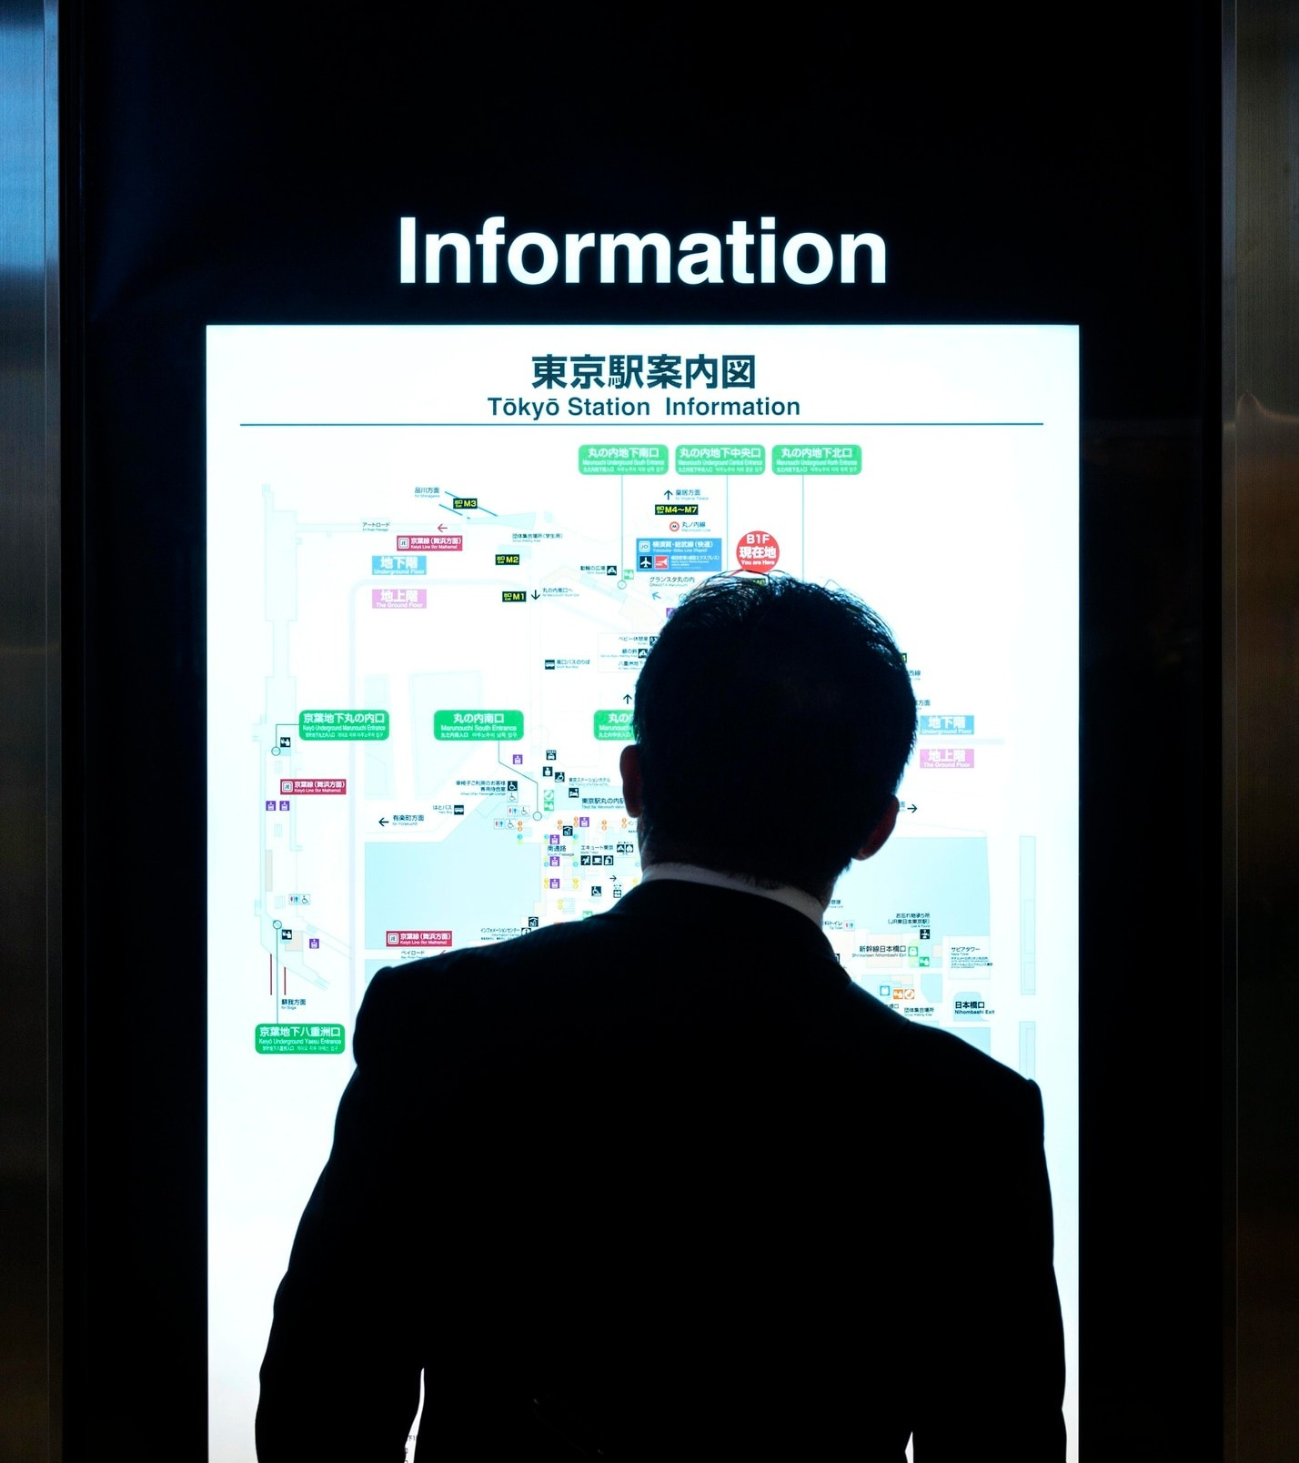
Challenges and Considerations
While optimizing virtual memory performance is beneﬁcial, it comes with its own set of challenges and considerations. We will address factors such as memory fragmentation, workload diversity, and hardware constraints that impact virtual memory
efﬁciency.

Slide 11

Future Research Opportunities
The ﬁeld of virtual memory optimization presents exciting avenues for future research and development. We will explore potential research directions such as machine learning- based page replacement and adaptive memory management to further enhance system performance.

Slide 12

Key Takeaways
Reﬂecting on the insights gained from this presentation, it is evident that optimizing virtual memory performance is a multifaceted endeavor. By understanding the intricacies of paging and page replacement algorithms, we can effectively enhance system efﬁciency and responsiveness.

Slide 13
Conclusion
In conclusion, the simulation of paging and advanced page replacement algorithms has provided valuable insights into optimizing virtual memory performance. By leveraging the knowledge gained, organizations can enhance system efﬁciency and responsiveness, ultimately improving user experience and productivity.

Slide 14
Thanks!
Do you have any questions? youremail@email.com
+91 620 421 838
www.yourwebsite.com @yourusername

